Slide 1






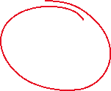

























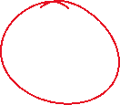

Slide 2

















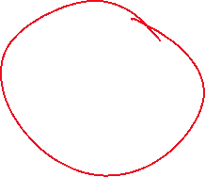













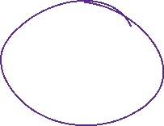



SELF ATTENTION
ATTENTION – ALL YOU NEED (PAPER)
S1: THE ANIMAL DIDN’T CROSS THE STREET BECAUSE IT WAS TOO TIRED.
S2: THE ANIMAL DIDN’T CROSS THE STREET BECAUSE IT WAS CONGESTED.

Slide 3







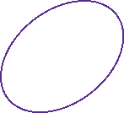

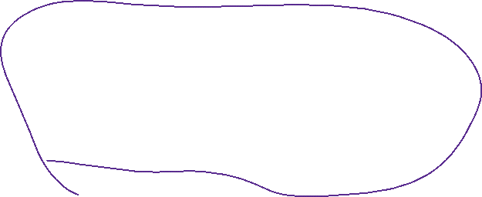




















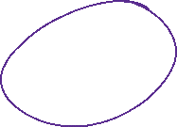























WHENEVER WE ARE TRYING TO COMPUTE NEW REPRESENTATION FOR SOMETHING → WE WILL CALL THAT AS QUERY VECTOR ..

Slide 4





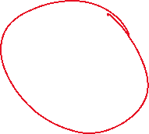

































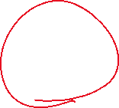

Slide 5







































Slide 6


























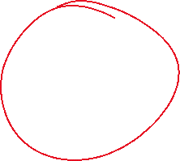










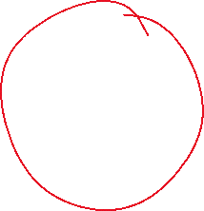




Slide 7


































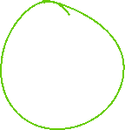









Slide 8






























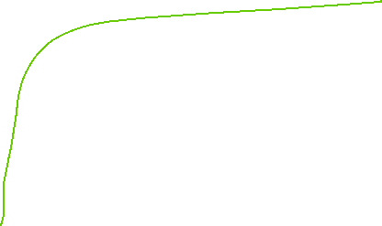

SCALED DOT PRODUCT HEAD .. SELF ATTENTION..

Slide 9





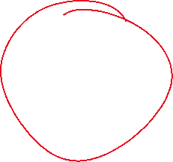





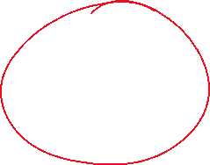














In CNN, we used to have multiple filters. → Why ? → Each filter/kernel is learning some different abstract representation.
Motivation of MULTI-HEADED ATTENTION : If we can have multiple filters in CNN, why not we can have multiple SELF ATTENTION heads.

Slide 10
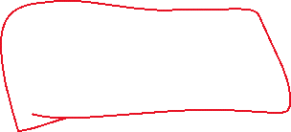




























Slide 11
































Slide 12
TRANSFORMERS
2 PARTS (ENCODER + DECODER)
* ENCODER (SELF ATTENTION + MULTI HEADED SELF ATTENTION + LAYER NORMALIZATION + FEED FWD. NN + SKIP NETWORKS CONNECTION + POSITIONAL ENCODING)
https://medium.com/@abhishekjainindore24/transformer-architecture-part-1-encoder-d90835db56b5
* DECODER (MASKED SELEF ATTENTION , MASKED MULTI SELF ATTENTION, CROSS ATTENTION, LAYER NORM, FEED FWD. NN, LINEAR, SOFTMAX.. )
MULTIPLE BLOCKS ..
https://jalammar.github.io/illustrated-transformer/
CODE: https://d2l.ai/chapter_attention-mechanisms-and-transformers/transformer.html

Slide 13
VARIANTS OF TRANSFORMER
ONLY ENCODER ARCHITECTURE – BERT → ROBERTA, DISTILLBERT
ONLY DECODER PART OF TRANSFORMER → GPT, CHATGPT, LLAMA
OUT OF SCOPE (BETTER TO READ OF YOUR OWN) ..
OPTIMIZATION – LoRA, KV CACHE, FAST ATTENTION, LOCAL/BLOCK ATTENTION ,
GROUPED QUERY ATTENTION (GQA), PAGED ATTENTION

Slide 14


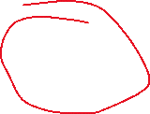












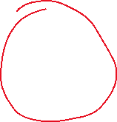




POSITIONAL ENCODING

Slide 15
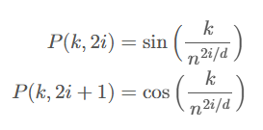
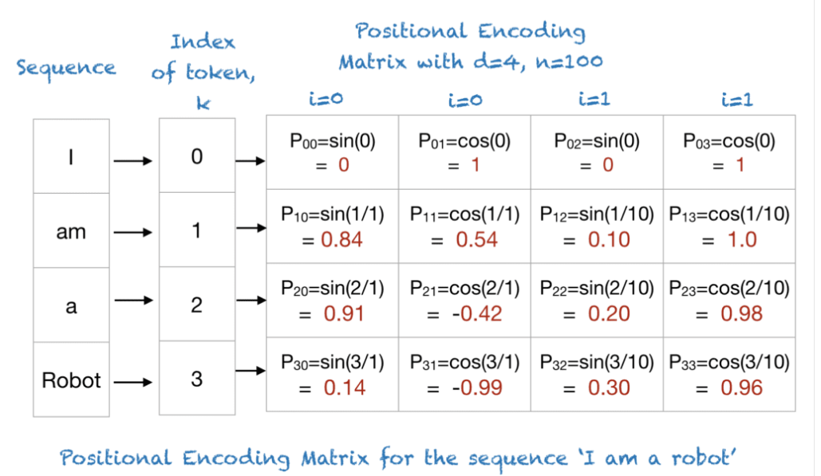










A Gentle Introduction to Positional Encoding in Transformer Models, Part 1 - MachineLearningMastery.com

Slide 16




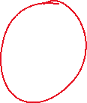







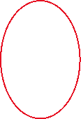
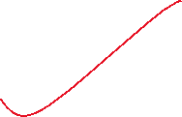





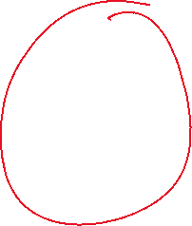


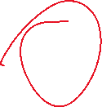




















In the decoder, the self-attention layer is only allowed to attend to earlier positions in the output sequence. This is done by masking future positions (setting them to -inf) before the softmax step in the self-attention calculation.

Slide 17












